Slide 1





openVirus
Scientific Knowledge for citizens in the time of COVID
TheContentMine and Others Presented by Peter Murray-Rust
Virtual, 2020-08-12
https://www.slideshare.net/petermurrayrust/open-virus-indian-presentation
A new knowledgebase by/for citizens
INYAS
NIPGR
KARYA
pm286@cam.ac.uk
peter@contentmine.org
Images from ContentMine CC BY and Wikimedia CC BY-SA

Slide 2
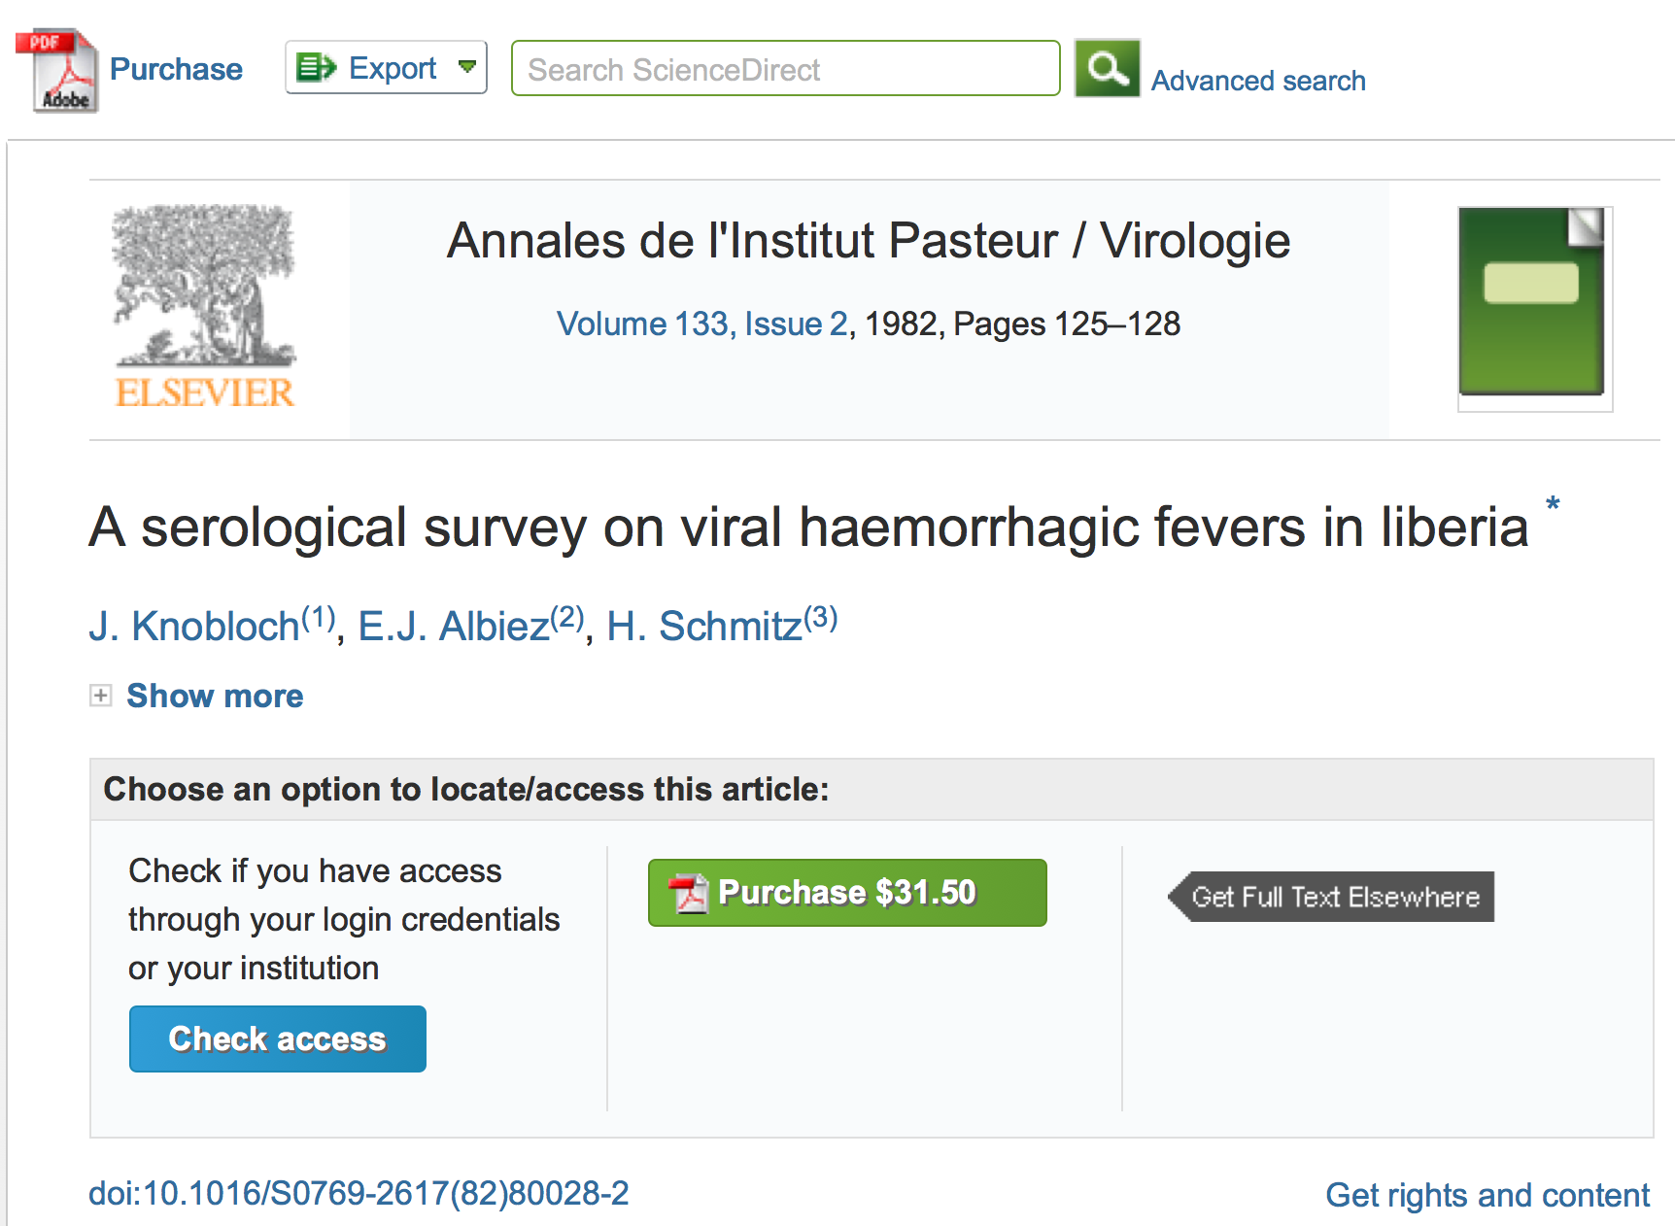
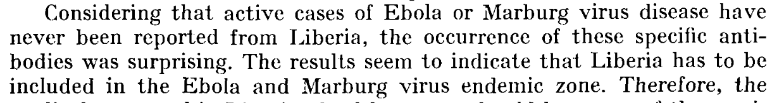
1982 scientific paper predicts 2015 Liberian Ebola outbreak
Can we use machines to scan the whole literature For VIRAL EPIDEMICS?
UPDATE: Aug 2021

Slide 3
TIGR2ESS 2019 Delhi Food Security FEB 2019
KARYA
INYAS
Developed Virtually over 6 weeks!
Priya and Kareena interns on openVirus
JUNE 2020
What can we discover about VIRAL EPIDEMICS?
2020-06-01

Slide 4
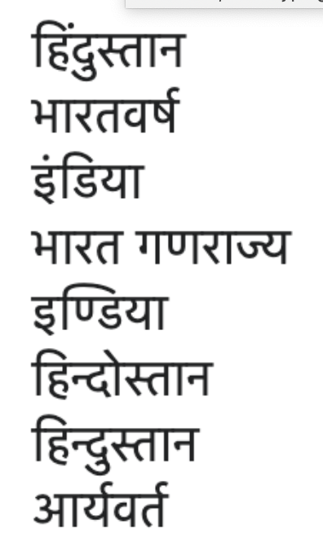
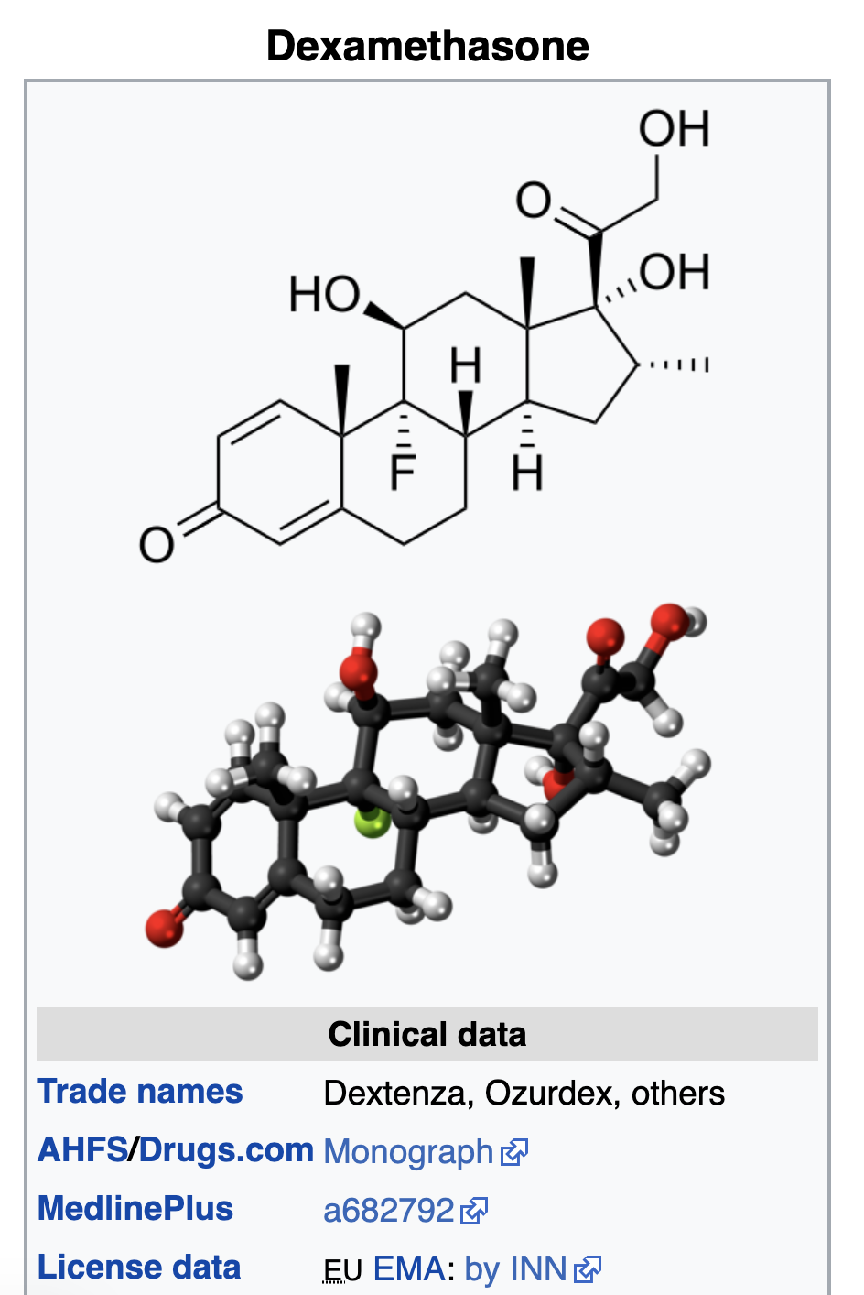
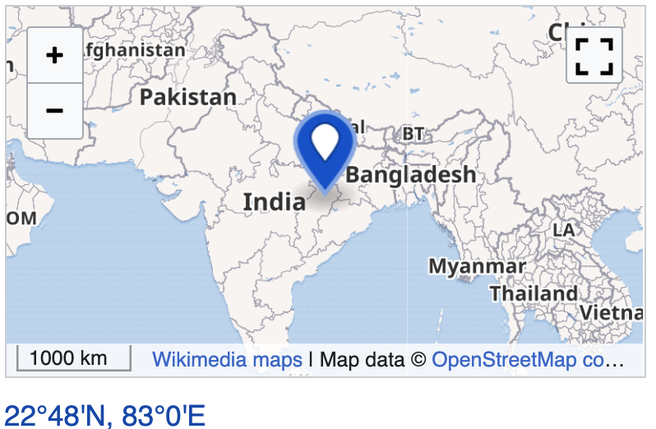
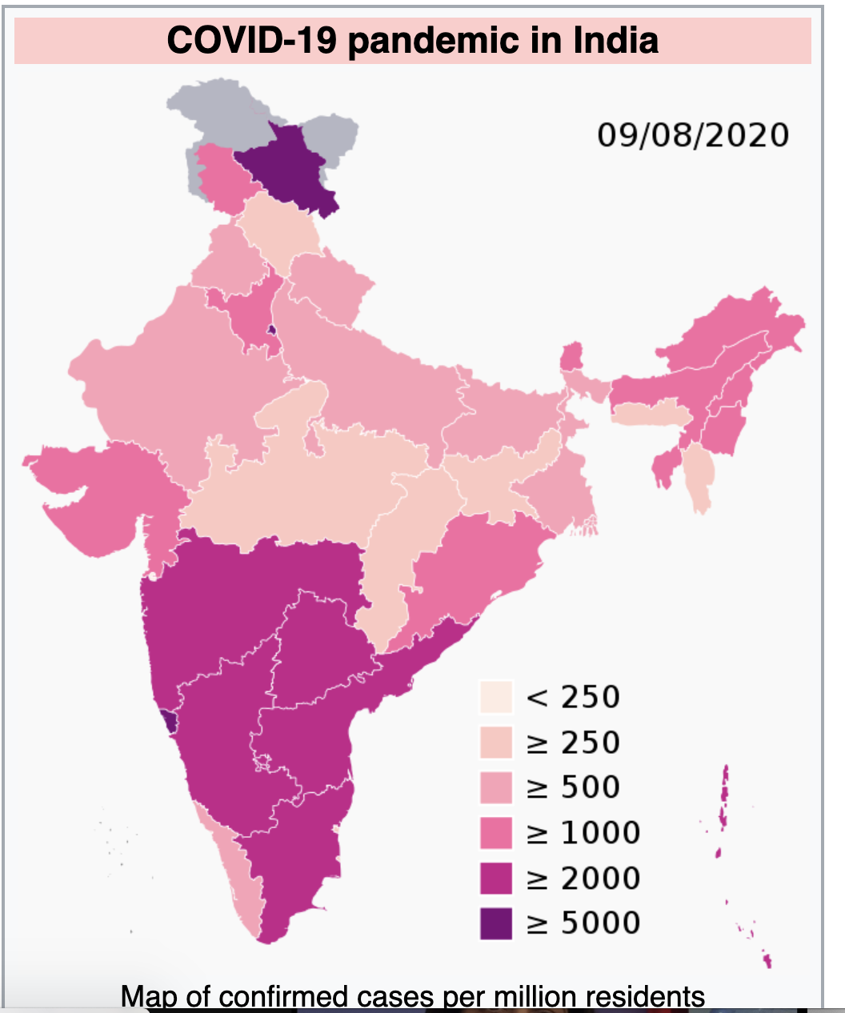
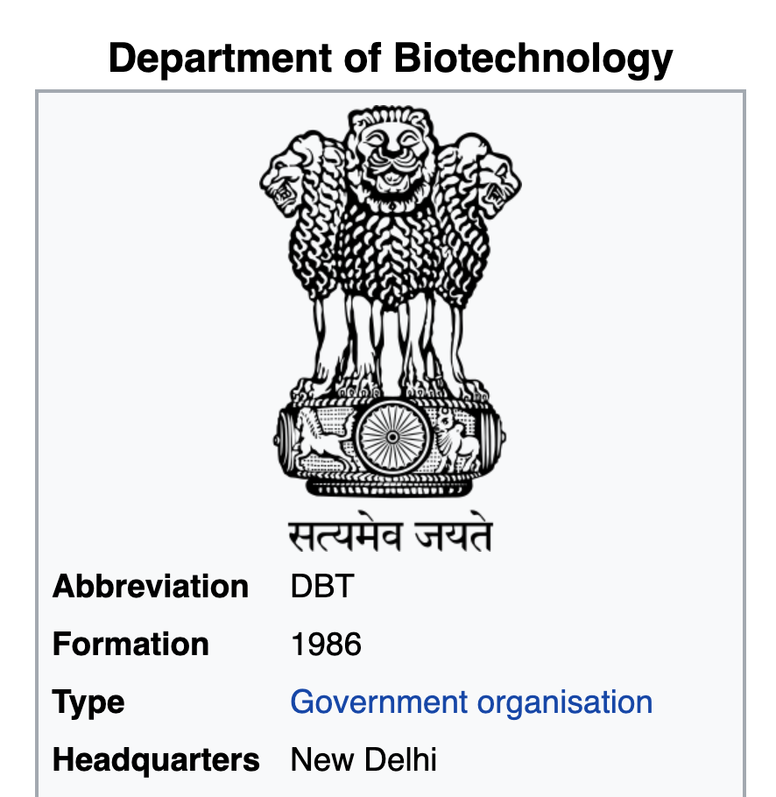
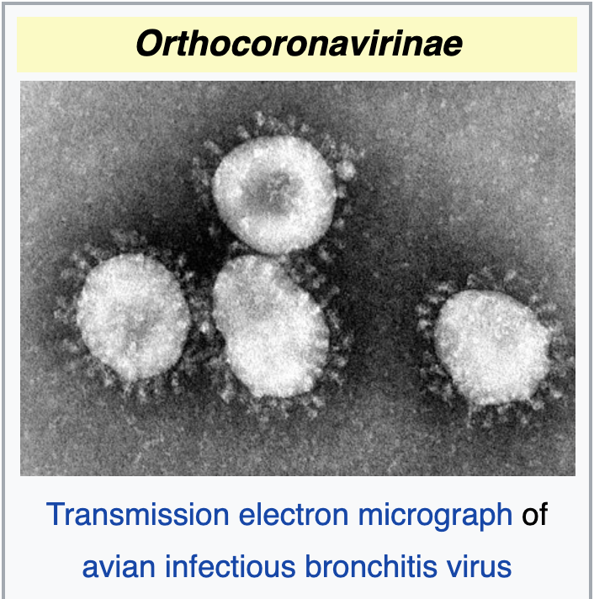
5 core facets
country
drug
Multilingual
disease
funder
virus

Slide 5


8 miniprojects
Corpus (950 docs)
Dictionary (3000 terms)
- country
- disease
- drug
- funder
- virus
3 complex topics: - zoonosis (animal hosts) - non-pharmaceutical (masks, social distancing, etc.) - test and trace

Slide 6

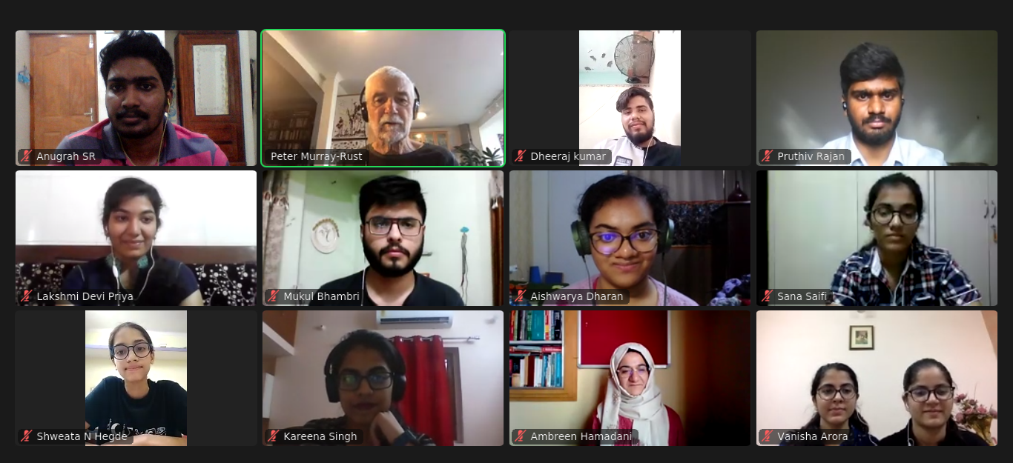
It’s also about…
Whom we include and collaborate with
3.
Outreach!
cambiohack
serendipitous encounters!
Notes:
Traffic Lights -> Spreadsheet + literal traffic light
Daily Stand-ups
What I did
What next
Blockers
Community
Icons > Textual information

Slide 7

Global Crises: UN Sustainable Development Goals

Slide 8
Open projects

Slide 9
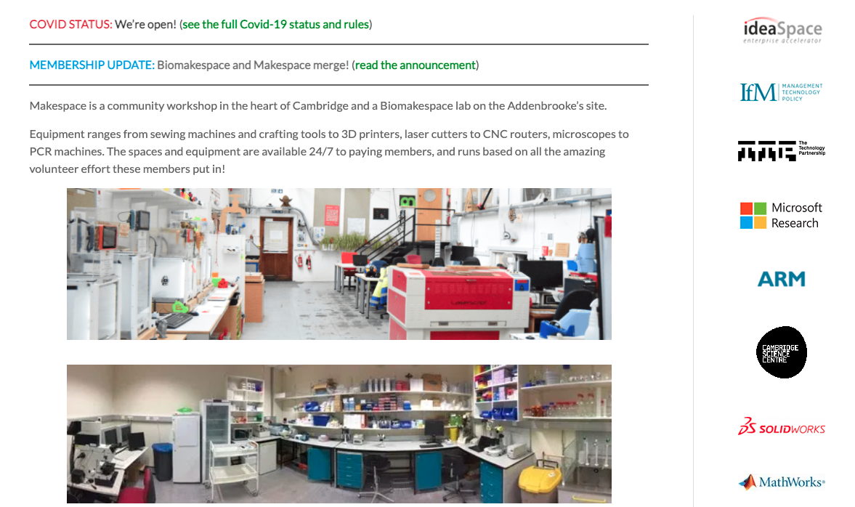

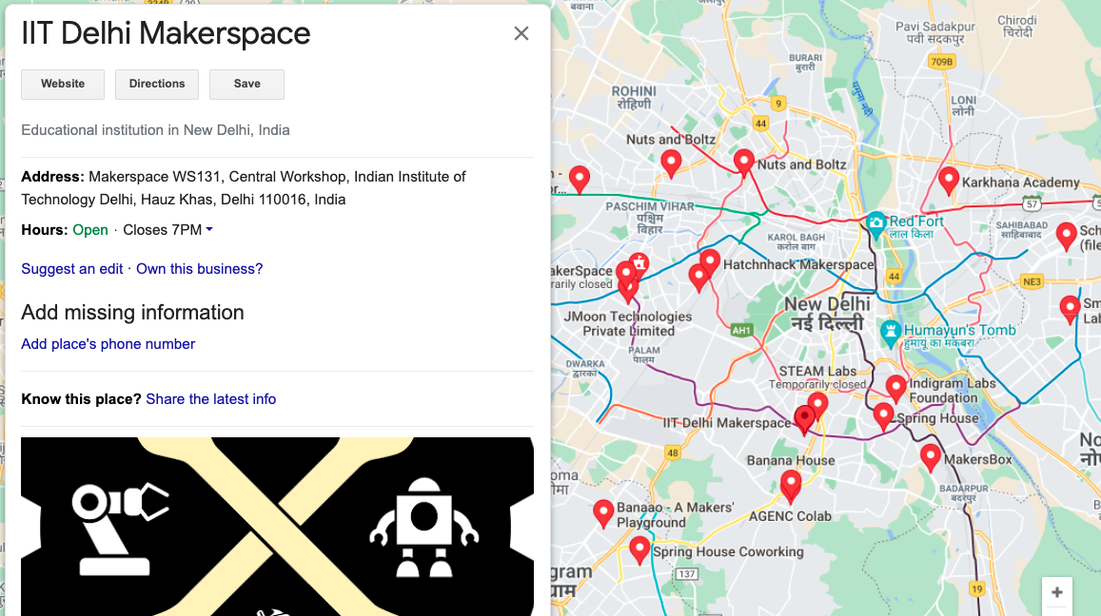

Slide 10
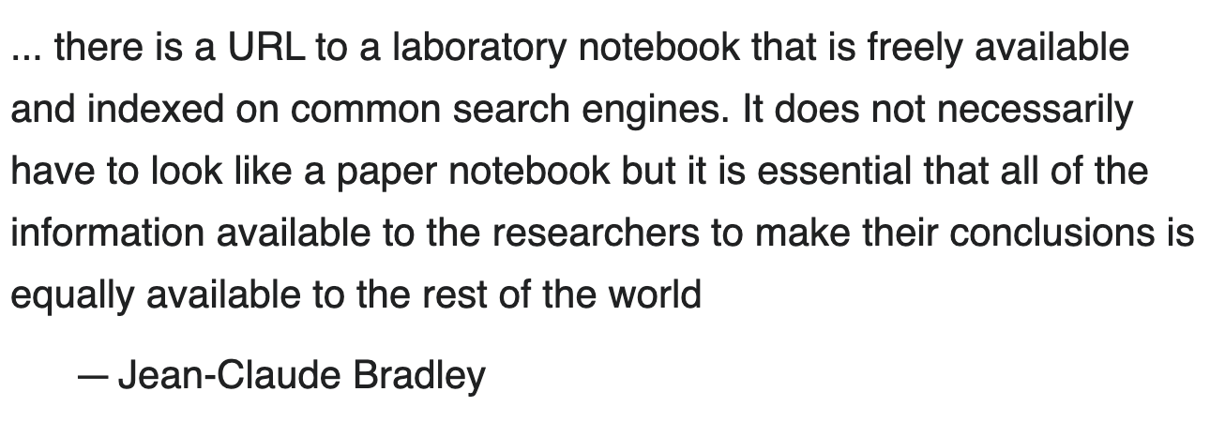
Open (Notebook) Science
Inclusive by
age, geography, education, race, gender, language…
Examples:
Human Genome Project
GalaxyZoo/Zooniverse
Open Source Drug Discovery (IN)
Mozilla and Wikipedia
Open Access and Open Source do not imply Open Science

Slide 11
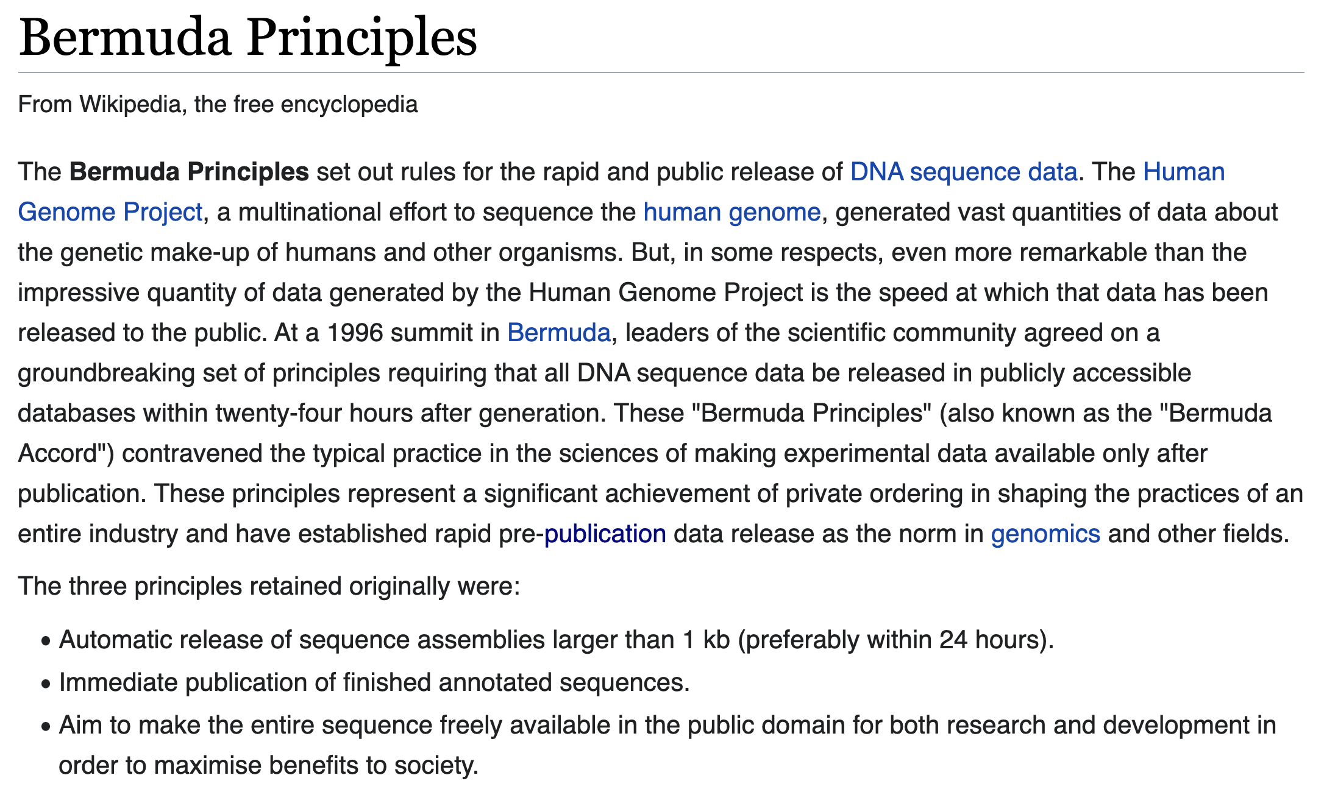
(Human Genome Project)
… all DNA sequence data [should] be released in publicly accessible databases within twenty-four hours after generation

Slide 12
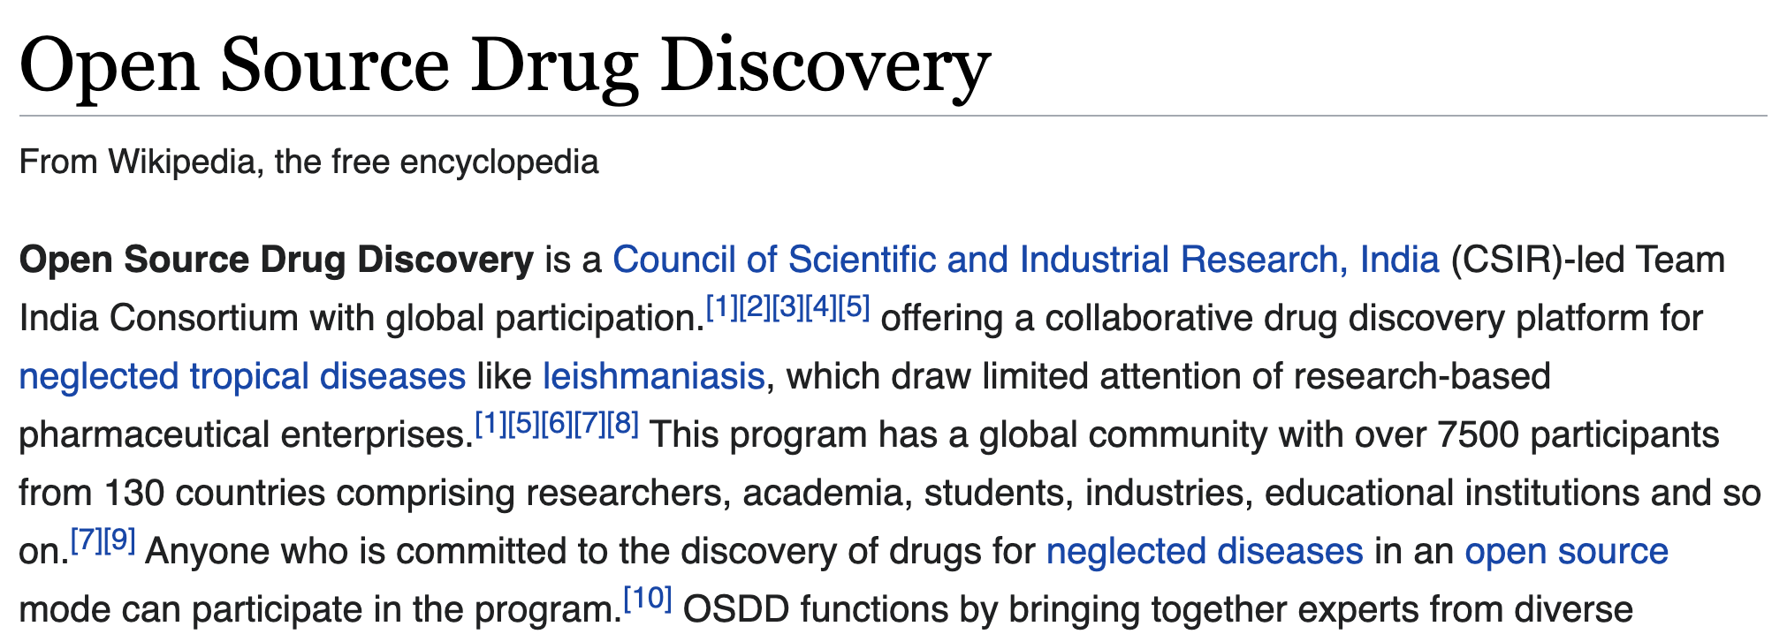

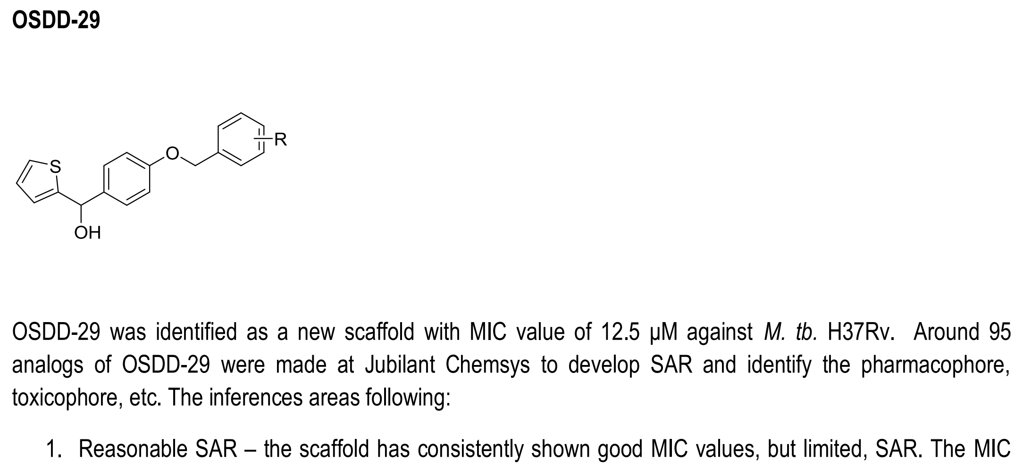
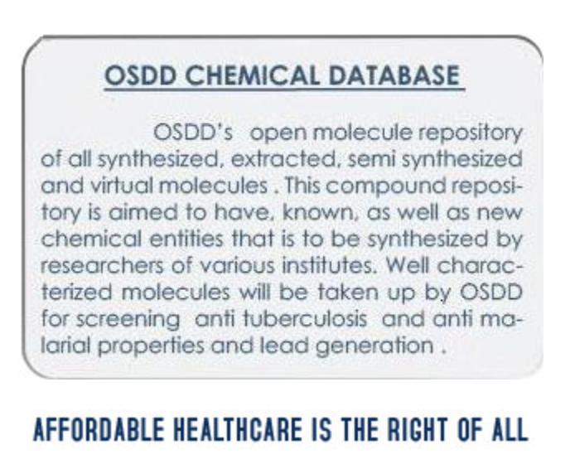


Slide 13
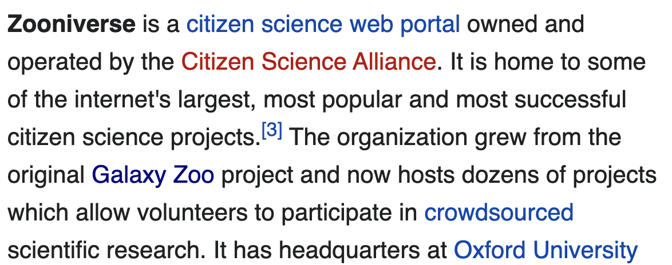
Classification
Annotation++ Decision Tree Filtering+ Transcription
Pattern Finding
including astronomy, ecology, cell biology, humanities, and climate science.^{[5]}

Slide 14
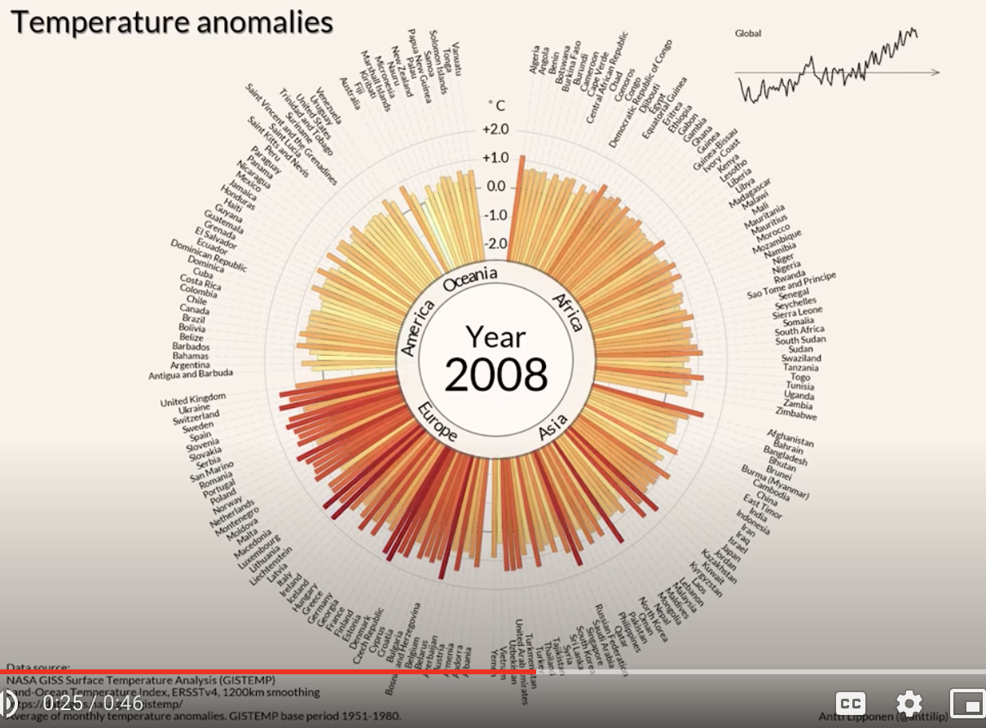
Awareness: Data that cannot be ignored
Antti Lipponen (@anttilip) of the Finnish Meteorological Institute based on GISTEMP data (CC BY 2.0).
https://twitter.com/dwallacewells/status/1312121745927598080/photo/1
Click this and
be very afraid =>
https://www.youtube.com/watch?v=-yIHxOui9nQ&ab_channel=CarbonBrief

Slide 15
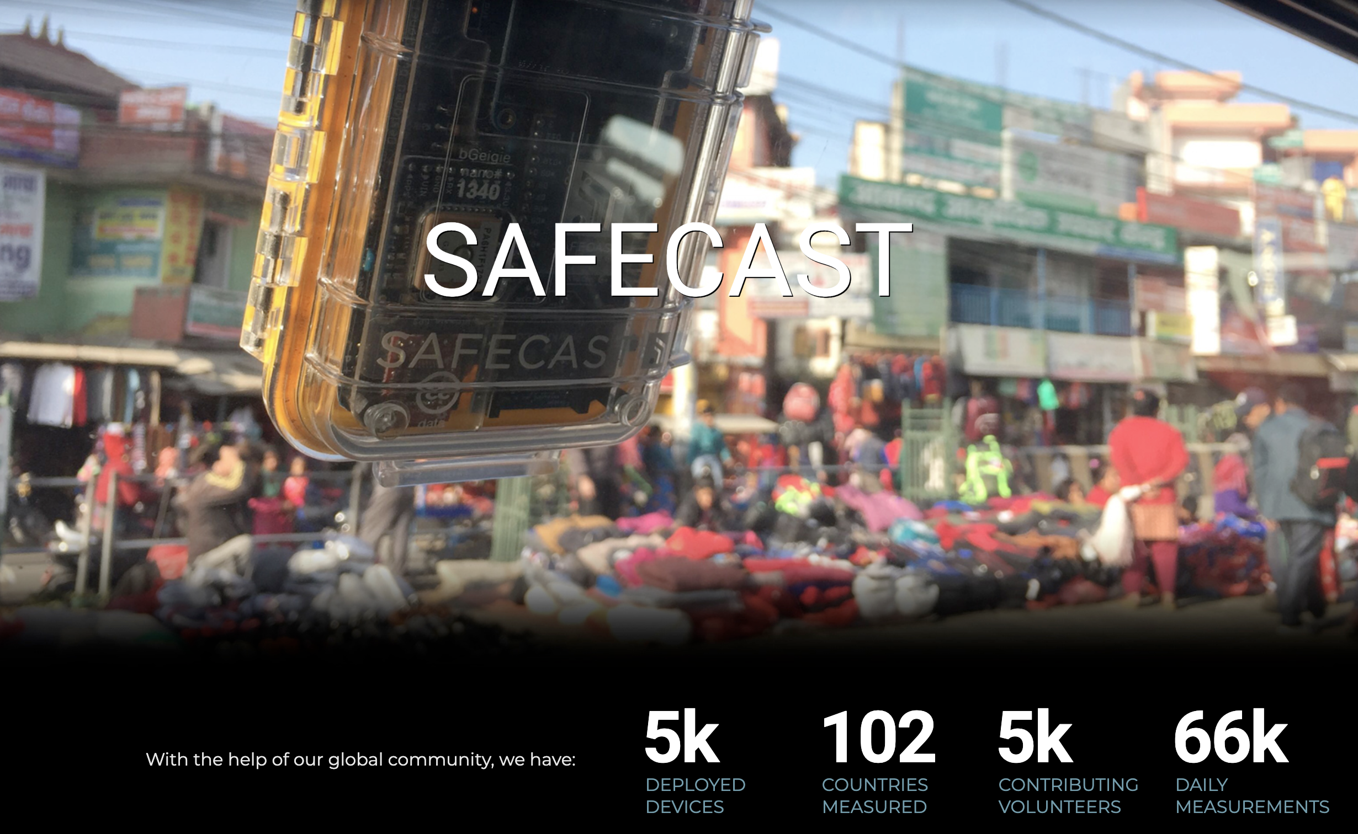
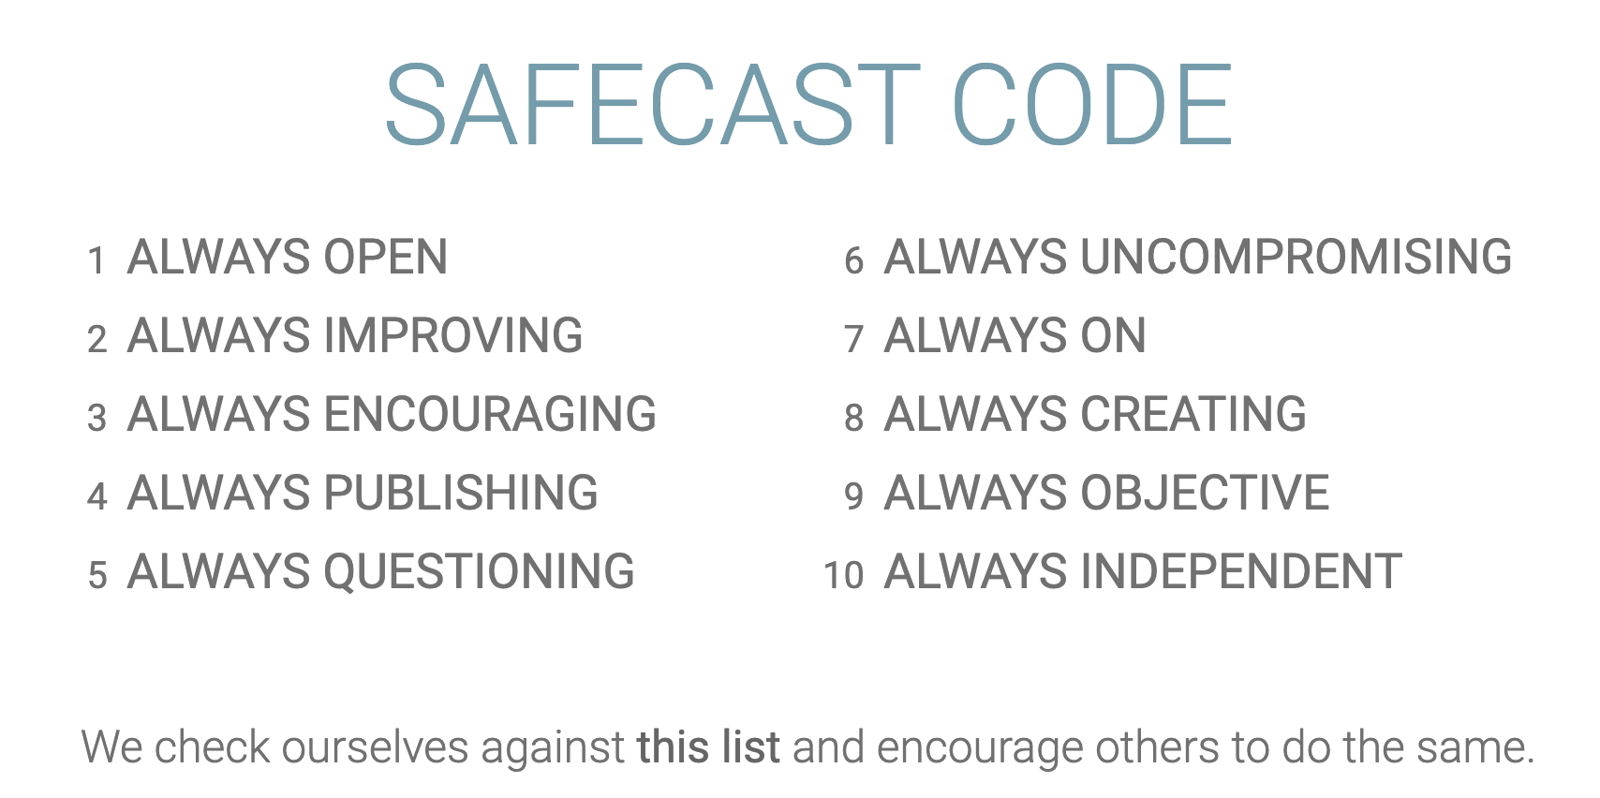
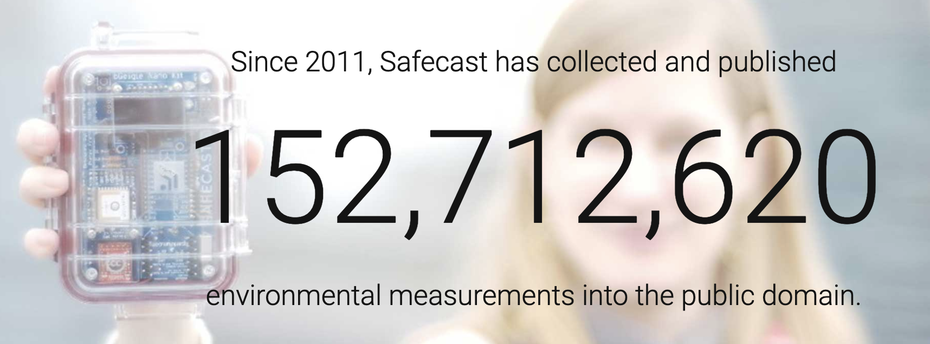
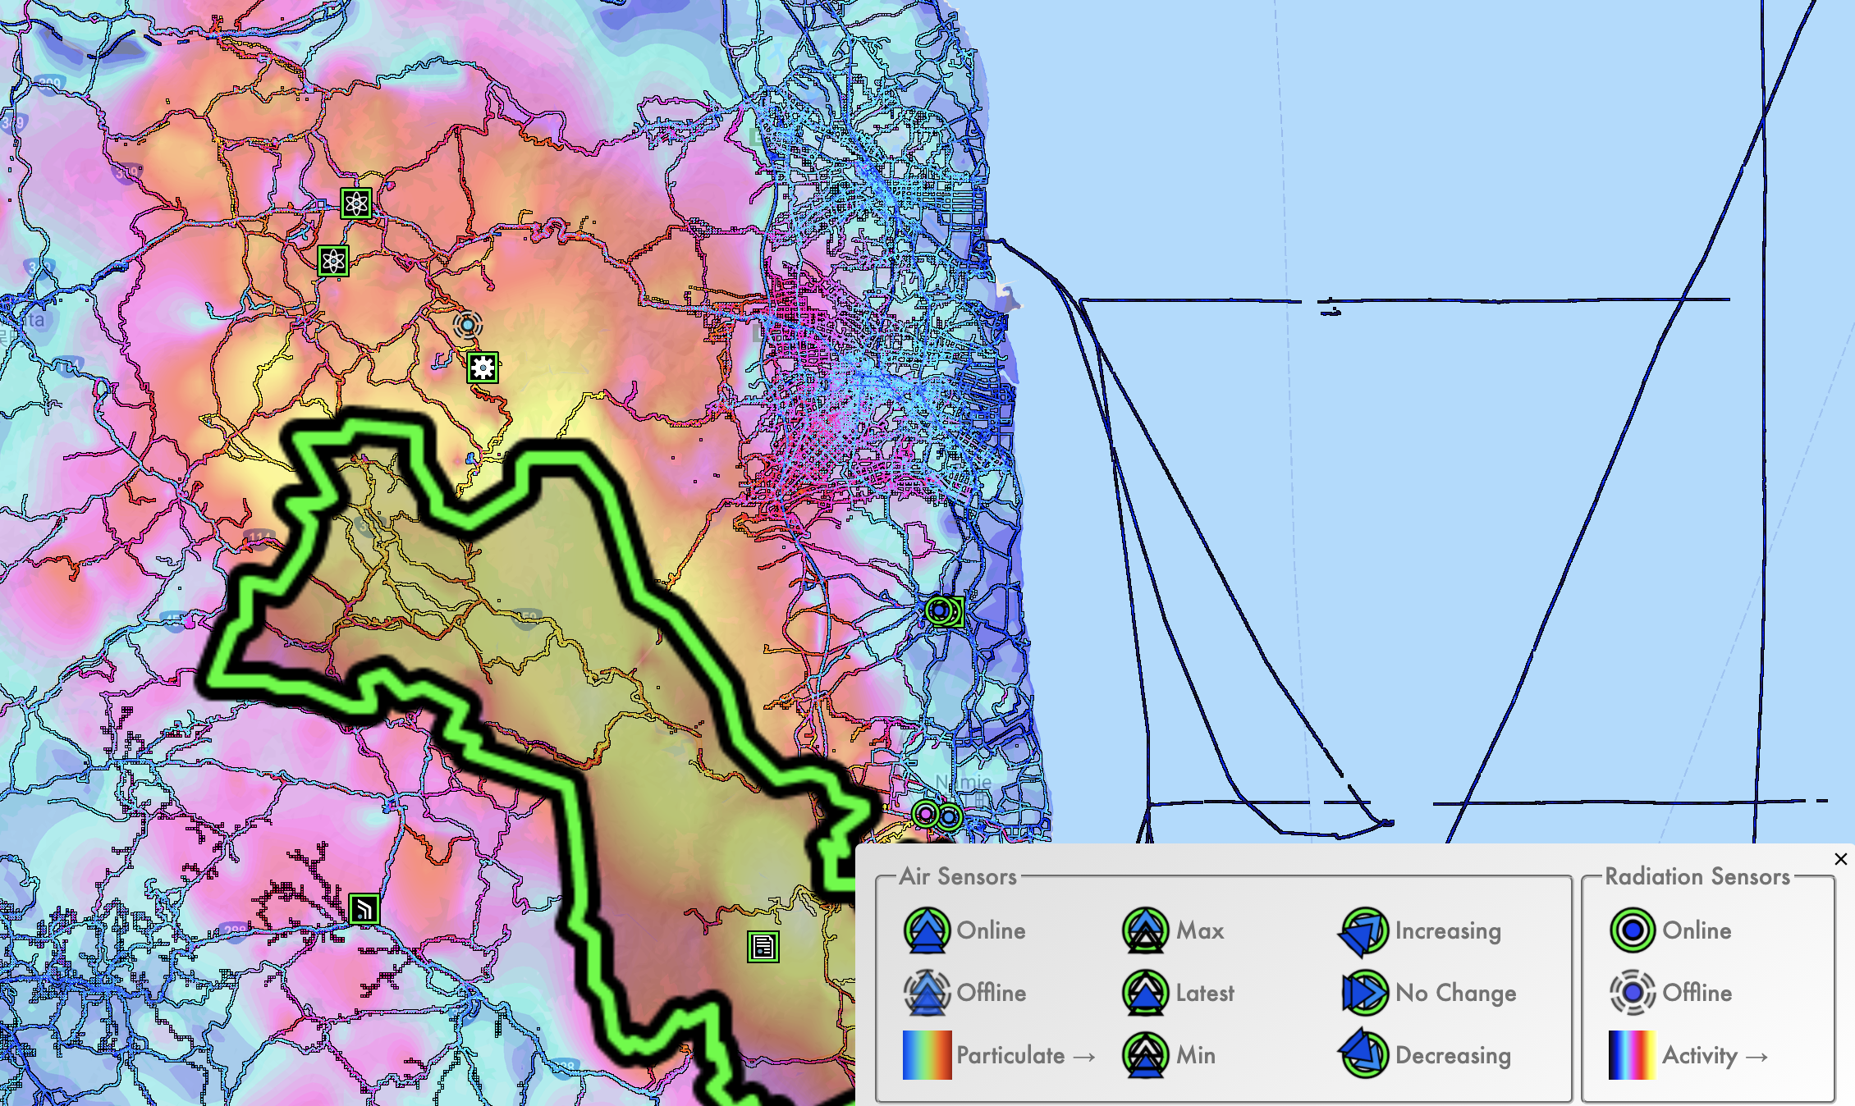
Fukushima
Every data point collected by a volunteer

Slide 16
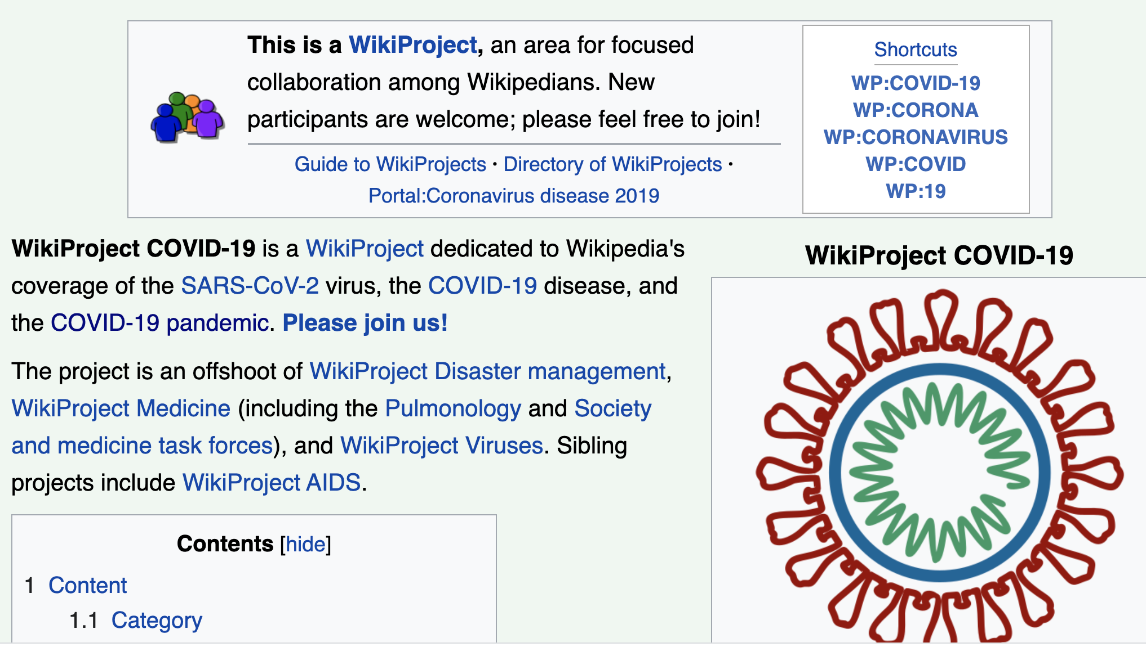
WikiProject COVID-19

